Slide 1
DevOpsing in a Microsoft World
Notes:
Thank you for having me back Seattle! My name is Scott Nasello and I’m excited to talk about our experiences with a Microsoft enterprise.
The last few months have reinforced the importance of the learning organization to our DevOps journey, so this talk has changed a bit from the original idea.

Slide 2
“A 5 hour road trip to an amusement park on the hottest day of the year”
Notes:
It’s really like that vacation your mom planned, to take you and a couple friends to the amusement park a short 5 hour drive away on the hottest August day of the summer. That’s the trip you learn that one of your neighbor friends is really weird, someone was inevitably going to throw up in the car and others are going to follow, your mom is going to power you through it, and the family truckster will take some messy hits. But you’re glad you didn’t miss the opportunity to hit that park and now you know how weird your neighbor is. And as long as you have that car, you will know where to look to see those stains that will remind you of that trip.

Slide 3
DevOps Challenges
Normal, rational hesitation to widespread change
Functional silos, organizational alignment
Typical Agile-Lean-DevOps (ALDO) challenges
Typical
Organization
+
Monolithic tools, screenshots, “click next”
Closed source, undocumented APIs, friction
Reliance on vendors for direction, road mapping
Silos encouraged by Microsoft
“Microsoft”
Organization
+
Commercial Off The Shelf (Buy vs. Build)
Limited engineering tradition
Buy vs Build
Organization
Notes:
Microsoft has changed quite a bit under Satya via Azure and PowerShell, however many enterprises likely have substantial residue remaining

Slide 4
Core Challenge:
Enduring DevOps transformations require a commitment to learning
Notes:
Regardless of the background, all organizations share a common challenge:

Slide 5
“A learning organization is an organization skilled at creating, acquiring, and transferring knowledge, and at modifying its behavior to reflect new knowledge and insights”
- Professor David A. Garvin, HBS

Slide 6
If you want to “do the DevOps” and don’t have a learning organization, what do you do?

Slide 7
Growth Mindset?
Notes:
Is it enough to tell your teams to have a growth mindset?
I had a feeling we don’t appreciate the difficulty and pain of re-developing a growth mindset

Slide 8
Interviews:
Describe Journey
Favorite/least favorite aspect
Advice to the 2015 you
Anticipating in next 2 years
Notes:
How would you describe the journey we’ve been own over the last 2 years?
What’s been your favorite aspect of this journey?
What’s been your least favorite aspect of this journey?
What would you tell your “2015 self” about the journey you are about to go on?
What are you most eagerly anticipating over the next 2 years?

Slide 9
Describe the journey we’ve been on over the last 2 years
Notes:
Is it enough to tell your teams to have a growth mindset?
I had a feeling we don’t appreciate the difficulty and pain of re-developing a growth mindset

Slide 10
Rewarding, bumpy, and lots of self doubt, I definitely felt like an imposter. Eventually: “I felt like I could grow/contribute”

Slide 11
The team has grown quite a bit but can regress to old ideas and mindsets; I learned quite a bit about dealing with folks I don’t agree with

Slide 12
It has been hard to ramp up due to the slew of tools, behaviors, and new ways of thinking

Slide 13
What’s been your favorite aspect of the journey?
Notes:
Is it enough to tell your teams to have a growth mindset?
I had a feeling we don’t appreciate the difficulty and pain of re-developing a growth mindset

Slide 14
I have enjoyed expanding my sphere of responsibilities and interests by breaking down IT silos. The variety and level of activity within the team has been rejuvenating

Slide 15
I enjoy being on the leading edge of enterprise IT. DevOps is not new for unicorns but it is still in beginning stages in Microsoft centric enterprises.

Slide 16
The encouragement to experiment (fail) without the fear of punishment, especially with ChatOps

Slide 17
People, Teammates, Mentorship, Learning to ask for help; Developing confidence

Slide 18
What’s been your least favorite aspect of the journey?
Notes:
Is it enough to tell your teams to have a growth mindset?
I had a feeling we don’t appreciate the difficulty and pain of re-developing a growth mindset

Slide 19
Constant change...all the experiments, not enough time to go deep
Notes:
Constant change… all the experiments, not enough time to go deep
Adapting to change is difficult, especially for those in the field for many years
Not being able to devote enough time to new work
Feeling lost/helpless, discomfort due to width and breadth of areas
Windows makes it harder than it needs to be
Lack of prioritization across projects
The lack of time to experiment with technologies outside my immediate areas of responsibility has been frustrating

Slide 20
Feeling lost/helpless, discomfort due to width and breadth of areas
Notes:
Constant change… all the experiments, not enough time to go deep
Adapting to change is difficult, especially for those in the field for many years
Not being able to devote enough time to new work
Feeling lost/helpless, discomfort due to width and breadth of areas
Windows makes it harder than it needs to be
Lack of prioritization across projects
The lack of time to experiment with technologies outside my immediate areas of responsibility has been frustrating

Slide 21
Lack of prioritization across projects, maintenance, support

Slide 22
What advice would you give your 2015 self about the journey you are about to go on?
Notes:
Is it enough to tell your teams to have a growth mindset?
I had a feeling we don’t appreciate the difficulty and pain of re-developing a growth mindset

Slide 23
Be prepared to disappoint someone, It could be your manager, the business, your teammate, or yourself
Notes:
Over the next two years, you’re going to have to disappoint someone - It could be your manager, it could be the business, it could be your teammates, it could be your family, it could be yourself. You’re already at 100% and changing the way you work will seem like adding another 30% of work. Choose wisely who you disappoint, and remember that you’re not in this transformation alone – sacrifice a little of your teammates sanity when yours is depleted cause it will require that kind of team effort. Spend some time assisting the business units you support to be more self-sufficient – give them the tools and rights to help themselves so that you can focus on the true elements of infrastructure. The near future and speed of infrastructure isn’t going to allow itself to be built and maintained by a Microsoft Wizard that simplifies the process and guides you through every procedure – even MS is rapidly changing its toolsets in response to the reinvention of IT infrastructure. If you have any doubts, review what the sessions are at MS Ignite these days.

Slide 24
Don’t be overwhelmed by DevOps nirvana...try to stay focused on incremental improvements. Each improvement is like a savings deposit that will compound over time

Slide 25
Prepare for a lot of change; be willing to embrace the change; Reflect on why you do things...is it still valid? Was it ever valid?

Slide 26
Your existing skills are becoming obsolete and your expertise is at risk; Find a way to get started on new ideas

Slide 27
What are you most eagerly anticipating over the next couple of years?
Notes:
Is it enough to tell your teams to have a growth mindset?
I had a feeling we don’t appreciate the difficulty and pain of re-developing a growth mindset

Slide 28
Public Cloud
CHEF all the things
Automation
Notes:
These topics anticipated by the team is 180 degrees from where we started 2 years ago

Slide 29
Additional questions:
Career progression
Educational background
Vendor certifications

Slide 30
Observation:
Many veteran “IT Pros” started their career in help desk, advanced through the ranks, and likely bypassed college.

Slide 31
If you want to “do the DevOps” and don’t have a learning organization, what do you do?

Slide 32
“…Your goal is to pitch the ball where the bat will be…”
Notes:
The next time you pitch I want you to try to put the ball where the bat will be
…can you imagine how the kid will feel if he gets a hit?
...That experience will stay with the kid the entire year.
It’s not that I was trying to strike kids out, it was that I wasn’t mindful about the opportunity to cultivate self-esteem.
Is your transformation putting the ball where the bat will be?
Are you mindfully structuring your activities for inclusion?

Slide 33
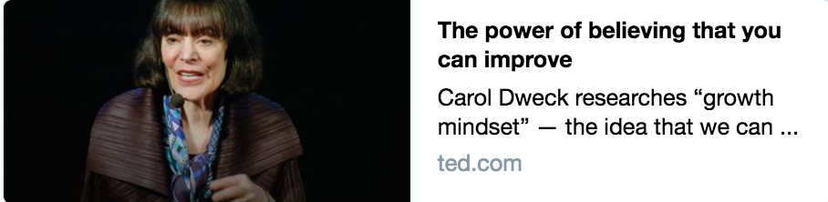
Let's not waste any more lives¹, because once we know that abilities are capable of such growth, it becomes a basic human right for children², all children², to live in places³ that create that growth, to live in places³ filled with "yet".
¹ careers
² people
³ workplaces

Slide 34
Let's not waste any more lives¹, because once we know that abilities are capable of such growth, it becomes a basic human right for children², all children², to live in places³ that create that growth, to live in places³ filled with "yet".
¹ careers
² people
³ workplaces

Slide 35
Let's not waste any more careers, because once we know that abilities are capable of such growth, it becomes a basic human right for people, all people, to live in workplaces that create that growth, to live in workplaces filled with "yet".
¹ careers
² people
³ workplaces

Slide 36
Hypothesis:
DevOps practices can be used to teach the organization to become a learning organization
Notes:
Imagine…we will use DevOps to build the learning organization and then use the learning organization to maintain the transformation.

Slide 37
SWOT Analysis ~2014
Strengths Vendor partnerships Exceptionally tight knit teams Expertise in storage & virtualization Strong operational background Entrepreneurial DNA Low turnover in team 99% virtualized with high availability
Weaknesses Reliance on vendors (COTS, Microsoft) Single threaded in numerous technologies Substantial legacy footprint Large population of long-lived servers Organization not “product” oriented Decentralized internal customers Low standardization / automation
Opportunities Centralized Infrastructure Engineering Under-challenged IT Pros 2 Engineers with scripting capabilities
Threats Potential disruption in retail

Slide 38
Public Service Announcement:
Your mindset as a leader matters
Notes:
The role of a leader in the learning organization is that of a designer, teacher, and steward who can build shared vision and challenge prevailing mental models. The leader is responsible for learning.
Here are some questions to reflect on:
Do you believe in your team?
Do you have the humility to let your teams see you going outside your comfort zone? Failing? Learning? Growing?
Are you prepared to lead by example?
In the goal we see activites being structured based on Herbie’s pace (so we don’t leave people behind)...Have you considered the capabilities of the team in structuring your own journey?

Slide 39
a servant-leader
an adaptive learner
a creative thinker
a global communicator
BE
yourself and seek self improvement
your people and help them achieve their potential
the doctrine, and know when to be constrained by it
your profession, contribute to it, and develop with it
KNOW
the right things right
provide a clear, actionable vision
make timely decisions
maintain balance and moderation
DO
Notes:
As a former Army officer I have high expectations of leaders and myself. The principles of Be, Know, Do are just as applicable to a DevOps context.

Slide 40
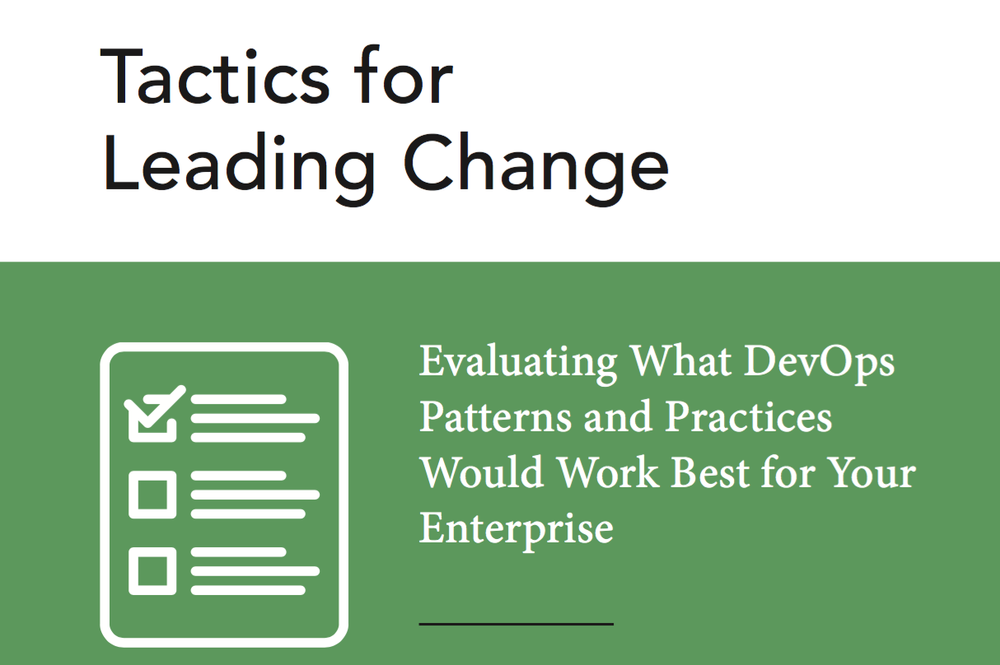
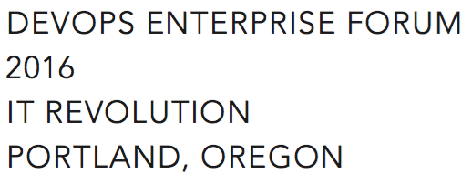
Small batch DevOps®
Make a compelling case for change (Tactic 14)
DevOps information sessions (Tactic 2)
Make Work Visible (Tactic 11) – TFS Kanban
Experiments (Tactic 4)
Gemba Walks (Tactic 9) - Go Observe
Later
Set WIP Limits (Tactic 13)
Blameless Retrospectives (Tactic 5)
Notes:
Tactics for Leading Change wasn’t available when we started but many of the early patterns are well-represented in the
Without accompanying changes in the way that work gets done, only the potential for improvement exists – David A. Garvin

Slide 41
Learning Org progression
Cognitive - 2015
Exposed to new ideas, expand their knowledge and begin to think differently.
Behavioral - 2016
Employees internalize new insights and alter behavior.
Performance Improvement - 2017
Changes in behavior leading to measurable improvements in results.

Slide 42
2015
Q1 Daily Standup → Weekly Standup TFS Kanban TFS Version Control : Goal 250 artifacts Conferences – spread wealth DevOps in a Microsoft World (Snover) Primary / Alternate engineer swaps
Q2 CHEF Conf 2015 x 10 Phoenix Project suggested reading Nordstrom reference calls PS & VMware vCloud Automation Center Prepare Workspace (TFS, .Net, PS, ChefDk) CHEF POC
Q3 Enterprise CHEF contract (700 nodes) Weekly Demos DSC Server provisioning (PoshOrigin) Difficulty stabilizing tools, automation Height of frustration ☹ PowerShell onsite training
Q4 Simplified PoshOrigin: WSIWYG CHEF Greenfield via Server provisioning Automation for ransomware remediation Curious people series Desktop PowerShell module CHEF: 100+ Greenfield Servers 500+ artifacts in version control

Slide 43
2016
Q1 Greenfield N-Tier App with CHEF CHEF onsite training Slack experimentation Work visibility & analytics – TFS + PowerShell Clean up ticketing system Vmware DevOps investigation (vRA, etc.) All in one monitoring solution
Q2 Exploration: PS script consumption Automation: psake, pester, Artifactory Stretched vSAN cluster Data Center migration via automation PowerShell module to manage TFS Kanban Community: DevOpsDays Portland Sponsor CFPs for tech conferences
Q3 Ideas: VelocityConf - ChatOps & Rotations Book: “Team of Teams” McChrystal Organization: Cross functional re-org SCM: GitLab – version control & CI/CD ChatOps: CHEF + Hubot + Slack + GitLab Automation: O365 Exchange in Cloud
Q4 Exploration: scripting for AWS/Azure, EMC Challenges: Loadbalancer pains, SOX 404 CHEF: 500+ Servers & CHEF Automate ChatOps: 150+ scripts, “Etsy Day 1” Friction: Prioritization, Principles Org: Hiring great engineers, rotations

Slide 44
2017:
Artifactory, CHEF, DSC, EMC, GitLab, Grafana, Hubot, InfluxDb, Jenkins, Nuget, OVF, Packer, Pester, *POSHOrigin, PowerShell, PowerCLI, psake, Sensu, Slack, Terraform, TFS (Kanban), Vagrant, Visual Studio, VMware, VS Code

Slide 45
2017:
Pods, Rotations, Cross-training

Slide 46

2017:
ChatOps
Notes:
Top Golf Story
“We should create a RYU for that”
Slack Rules of Engagement (Skype For Business, Workplace, etc.)
Azure Management & Costing, NetScaler, SharePoint, Teradata, Commvault, EMC, VMAX migrations

Slide 47
2017:
Scheduled Weekly Retrospectives

Slide 48
2017:
Azure PaaS: 10+ POCs, ”Cloud first”, Terraform, ARM templates

Slide 49
2017:
CHEF: 1300+ Nodes, Sensu, Compliance

Slide 50
2017:
Green/Blue

Slide 51
2017:
Learning labs

Slide 52
Hypothesis:
DevOps practices can be used to teach the organization to become a learning organization

